Slide 1
INCLUSIVE EDUCATION
12-Week SDG 4 Project
M.I. Hajwani English Medium School & Jr College, Khed
SDG Alignment: SDG 4 – Quality Education
Project Duration: 12 Weeks

Slide 2
Project at a Glance
OVERVIEW
The first three weeks establish the foundation, evidence base and sensitization direction.
12
SDG 4
100
20
Weeks of planned action
Quality Education
Students surveyed
Survey questions
Project Aim
Core Focus
Weeks 1–3
Promote an inclusive and equitable learning environment where students feel valued and supported.
Awareness • Accessibility • Peer Support • Inclusive Learning • Community Engagement
Launch → Sensitization Planning → Student Survey & Analysis
M.I. Hajwani English Medium School & Jr College, Khed • Inclusive Education Project • 2

Slide 3
Week 1 • Project Launch
WEEK 1
Committee formation and project proposal established the implementation framework.
Project Foundation
Leadership & Guidance
Topic: Inclusive Education
Department: English Department
SDG Alignment: SDG 4 – Quality Education
Duration: 12 Weeks
Led by the English Department
Chairpersonship: Mrs. Kadiri Shagufta – HOD, Science Department
Guided by: Mrs. Salva Tisekar – Principal
What Was Established
Project Direction
Student committees for:
• Awareness
• Accessibility Audit
• Peer Support
• Documentation
Create a school culture where every student feels valued, supported and has equal opportunity to learn.
M.I. Hajwani English Medium School & Jr College, Khed • Inclusive Education Project • 3

Slide 4
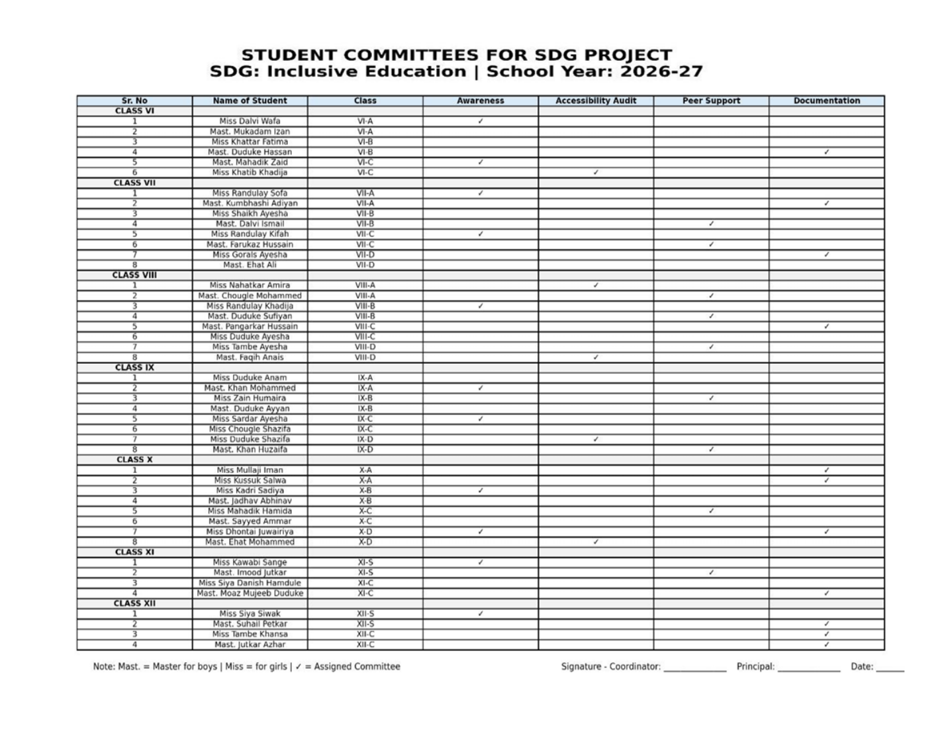
Week 1 • Student Committees
WEEK 1
Student committees were assigned across Awareness, Accessibility Audit, Peer Support and Documentation.
M.I. Hajwani English Medium School & Jr College, Khed • Inclusive Education Project • 4

Slide 5
Week 1 • Aim & Objectives
WEEK 1
The proposal defines six practical objectives for building an inclusive school environment.
Raise Awareness
Assess Needs & Gaps
Campaigns, sensitization drives and workshops on diversity, anti-bullying and inclusive language.
Needs assessment survey and accessibility audit of school infrastructure and resources.
Build Capacity
Peer Support Systems
Training on differentiated instruction, peer support and inclusive teaching practices.
Buddy system and peer mentoring for academics and practicals.
Engage Community
Document & Evaluate
Involve parents and special educators/experts to widen the support network.
Record best practices, case studies and feedback; measure changes in awareness and attitude.
M.I. Hajwani English Medium School & Jr College, Khed • Inclusive Education Project • 5

Slide 6
Week 1 • 12-Week Roadmap
WEEK 1
The proposal connects the launch to needs assessment, awareness, capacity building, evaluation and handover.
1
2
3
4
Launch
Needs
Assessment
Research &
Sensitization
Awareness
Campaign
5
6
7
8
Sensitization
Drive
Teacher &
Student Workshop
Accessibility
Audit
Peer Support
9
10
11
12
Inclusive
Learning
Community
Engagement
Evaluation
Presentation &
Handover
M.I. Hajwani English Medium School & Jr College, Khed • Inclusive Education Project • 6

Slide 7
Week 2 • Sensitization
WEEK 2
A school-wide awareness plan focused on learning disabilities, gender respect and diversity/inclusion.
Learning Disabilities
Gender Respect
Inclusive Classrooms
Increase understanding of common LDs and how peers can be supported.
Key message: “Learning differently isn't learning less.”
Promote equal treatment, participation and opportunities for boys and girls.
Key message: “Equal chances for everyone.”
Build respect for students from different backgrounds and identities.
Key message: “Everyone belongs here.”
Overall Purpose
Raise school-wide awareness and create a more supportive environment by connecting research, campaign messages and practical activities.
Intended Audience
Whole school • Students • Teachers • School community
M.I. Hajwani English Medium School & Jr College, Khed • Inclusive Education Project • 7

Slide 8
Week 2 • Research Themes
WEEK 2
The sensitization plan provides evidence-based messaging around three connected themes.
01 Learning Disabilities
02 Gender Respect
03 Diversity & Inclusion
• Dyslexia – reading
• Dyscalculia – mathematics
• Dysgraphia – writing
• ADHD – attention/focus
Core idea: learning disability is not linked to intelligence; appropriate support can help students succeed.
• Equal access to activities
• Equal leadership opportunities
• Encourage participation across subjects
• Avoid gender stereotypes in everyday language
Core idea: respect and opportunity should not depend on gender.
• Respect different backgrounds
• Strengthen empathy and communication
• Encourage classroom participation
• Build a healthier school climate
Core idea: differences in religion, ethnicity, language and family structure should not prevent belonging.
M.I. Hajwani English Medium School & Jr College, Khed • Inclusive Education Project • 8

Slide 9
Week 2 • Campaign Activities & Responsibilities
WEEK 2
The plan combines visual messaging, classroom discussion, storytelling, role play and assembly activities.
Awareness Activities
Assigned Responsibilities
Posters • LD role play/skit • Gender-respect class discussions • Storytelling • Assembly talk
Mrs. Hameeda Surve – LD posters & gender discussion
Ms. Fizaa Khatib – LD role play & storytelling
Ms. Ankita Pandey – gender posters & assembly talk
Week 4 Preparation
Week 5 Drive
Research finalisation → poster designs → key messages → skit/story rehearsal → inclusive-language guidelines → poster printing.
Poster displays → class sensitization → LD skit → whole-school assembly → feedback collection.
M.I. Hajwani English Medium School & Jr College, Khed • Inclusive Education Project • 9

Slide 10
Week 2 • Evaluation & Risk Management
WEEK 2
The campaign includes measurable indicators and practical mitigation strategies.
How Success Will Be Measured
Potential Risks & Responses
• Awareness change: before/after quiz or poll
• Participation: attendance at sessions
• Poster reach: number and locations
• Qualitative feedback
• Behavioural follow-up by teachers
Low budget → hand-drawn/low-cost materials
Limited assembly time → 5–7 minute talk
Low staff availability → involve student council/prefects
Sensitive reactions → age-appropriate language & optional sharing
Planning Principle
The emphasis of the campaign can be adjusted once needs-assessment data is available.
M.I. Hajwani English Medium School & Jr College, Khed • Inclusive Education Project • 10

Slide 11
Week 3 • Student Survey & Analysis
WEEK 3
A needs-assessment survey was used to understand learning needs, accessibility and inclusion.
100
20
3
1 / grade
Students surveyed
Questions
Survey sections
Class per grade level
Section A
Section B
Section C
Learning Needs
Lesson clarity • Difficult subjects • Teacher support • Classwork time • Extra help
Facilities
Accessibility • Quiet space • Safety • Signage • Seating
Gender & Diversity
Equal treatment • Respect • Voice • Equal opportunities • Inclusion activities
M.I. Hajwani English Medium School & Jr College, Khed • Inclusive Education Project • 11

Slide 12
Week 3 • Learning Needs — Key Findings
WEEK 3
The survey highlights both positive classroom experiences and clear areas for additional academic support.
42%
of students said at least one subject/lesson is especially hard.
Main Difficulties
Difficult concepts/chapters (18)
Lessons move too quickly (9)
English/terminology (7)
More examples/practice (5)
Concentration (3)
M.I. Hajwani English Medium School & Jr College, Khed • Inclusive Education Project • 12

Slide 13
Week 3 • Facilities & Accessibility
WEEK 3
The physical environment is generally viewed positively, with specific gaps identified for improvement.
Strongest indicator
89% feel safe moving around the school.
Accessibility
86% find facilities easy to use/reach.
Clear gap
Only 31% confirm a quiet/calm space is available.
M.I. Hajwani English Medium School & Jr College, Khed • Inclusive Education Project • 13

Slide 14
Week 3 • Gender & Diversity
WEEK 3
The findings support continued work on equal participation, respectful behaviour and inclusion.
22%
reported seeing/hearing unkind comments related to gender, culture or background.
88%
either want or might consider more activities focused on respect and inclusion.
Implication
Awareness and sensitization remain important.
M.I. Hajwani English Medium School & Jr College, Khed • Inclusive Education Project • 14

Slide 15
Week 3 • What Students Want to Change
WEEK 3
Open-text responses identify practical improvements students would value.
Kindness, respect & inclusion activities
24
More ramps / accessible pathways
16
Better / cleaner toilets & washrooms
14
More comfortable classroom seating
10
Handrails near stairs & ramps
8
More sports & recreational facilities
8
Quiet / calm space
7
More academic support / remedial classes
6
Better signage & directions
4
More opportunities to express opinions
3
Top request
M.I. Hajwani English Medium School & Jr College, Khed • Inclusive Education Project • 15
More activities promoting kindness, respect and inclusion.

Slide 16
Week 3 • Key Findings & Priorities
WEEK 3
The survey provides a clear evidence base for the next phase of the project.
01
Quiet / Calm Space
Only 31% confirmed one exists — the clearest facility gap.
02
Inclusion & Respect
22% reported unkind comments; 88% support or may support more inclusion activities.
03
Accessibility
Ramps, handrails and accessible pathways were prominent requested improvements.
04
Academic Support
42% find at least one subject especially hard; difficult concepts and pace were common concerns.
M.I. Hajwani English Medium School & Jr College, Khed • Inclusive Education Project • 16

Slide 17
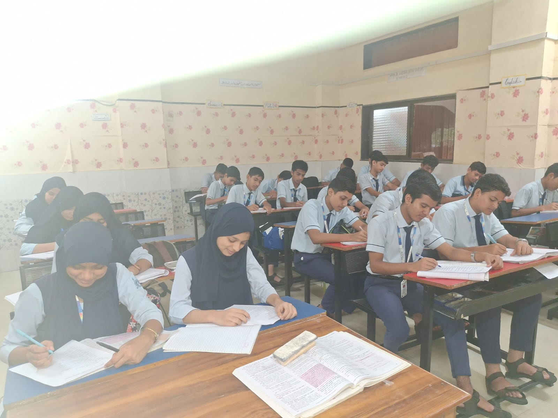
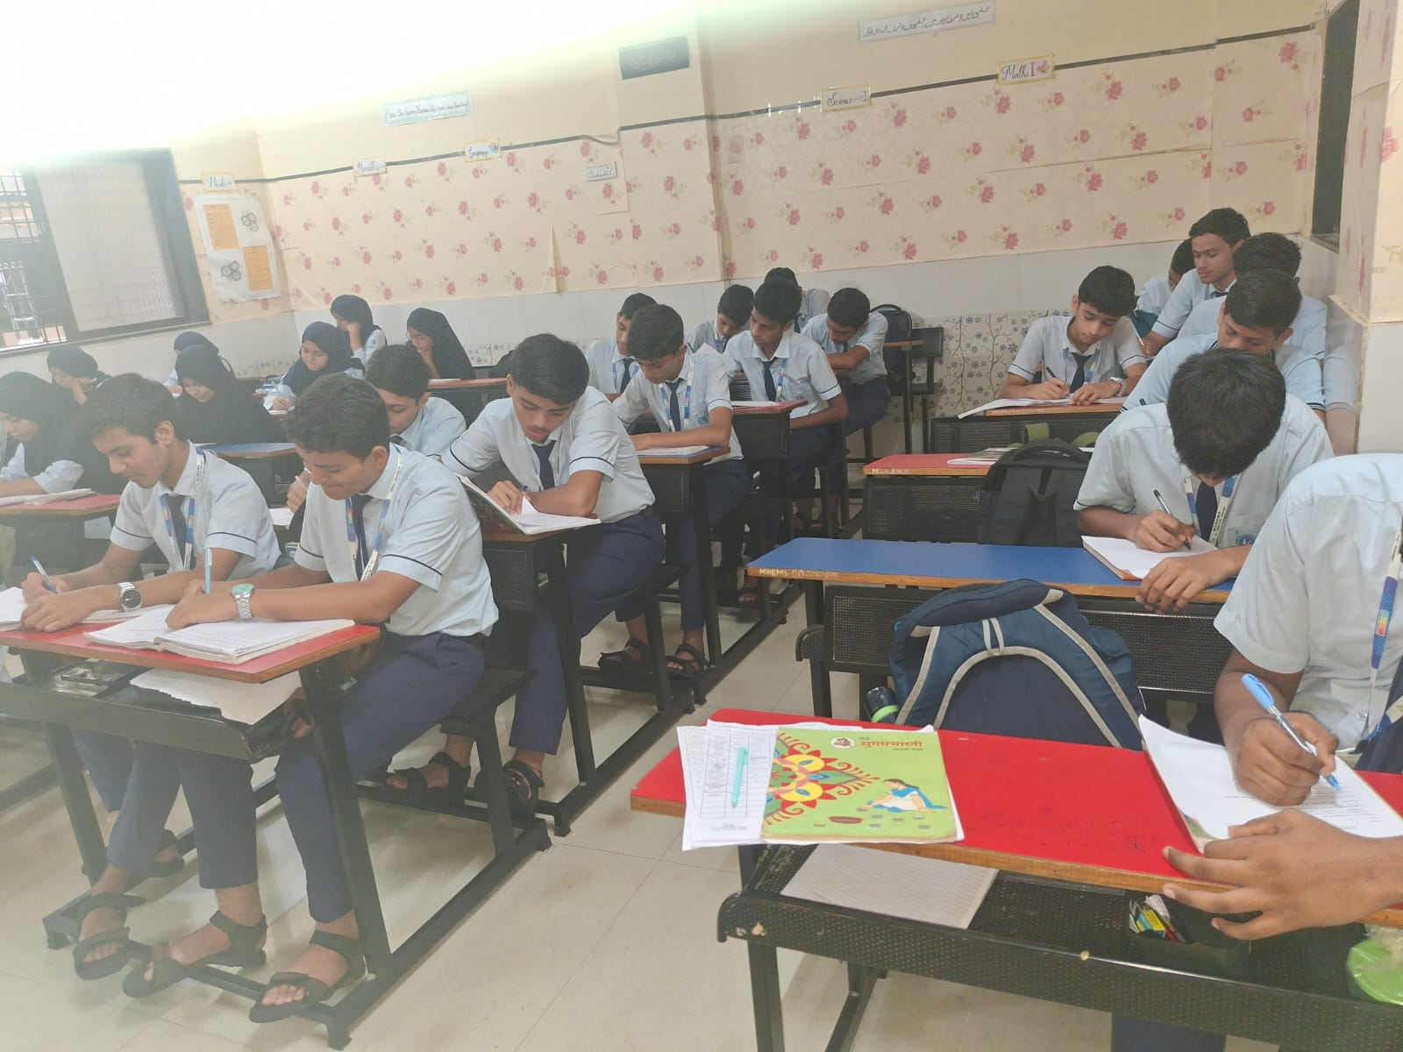
Week 3 •
WEEK 3
M.I. Hajwani English Medium School & Jr College, Khed • Inclusive Education Project • 16

Slide 18
WEEKS 1–3 • FOUNDATION ESTABLISHED
Week 1
Week 2
Week 3
Project launched
Committees formed
Aim & objectives defined
Sensitization themes defined
Campaign activities planned
Evaluation framework prepared
100-student survey
Findings analysed
Priorities identified
The project now moves from planning and evidence-gathering toward implementation, accessibility action, peer support and inclusive learning practices.
M.I. Hajwani English Medium School & Jr College, Khed • Inclusive Education Project • 17

Slide 19
Inclusive Language
WEEK
4
Using respectful communication that promotes equality, dignity and belonging.
M. I. Hajwani English Medium School & Jr. College, Khed

Slide 20
What is Inclusive Language?
Week 4 — Inclusive Education
Meaning
Why it matters
Inclusive language means using words that respect and include everyone, regardless of gender, age, ability, culture, religion, or background.
It helps create communication where people feel respected, valued and included.
SDG 4 connection
Inclusive communication supports equality, dignity and belonging — important principles of quality, inclusive education.
SDG 4 • Inclusive Education | Week 4
3

Slide 21
Inclusive Language Guidelines
Practical guidelines from the Week 4 material
01
02
Use respectful and non-discriminatory words.
Avoid stereotypes based on gender, race, religion, disability, or culture.
03
04
Use gender-neutral terms where possible — e.g., “chairperson” instead of “chairman”.
Use person-first and respectful language — e.g., “person with a disability”.
05
06
Respect people’s names, identities, and preferred terms.
Avoid words that may exclude, insult, or stereotype others.
07
Promote equality, dignity, and belonging in communication.
SDG 4 • Inclusive Education | Week 4
4

Slide 22
Student List
WEEK
5
Std. IX — Daisy, Rose, Marigold and Gerbera | Academic Year 2026–27
M. I. Hajwani English Medium School & Jr. College, Khed

Slide 23
Std. IX — Daisy
Student list • Part 1 of 2
01. Miss. Antuley Haifa Gulam Mohiddin
11. Miss. Khot Nawshin Sajjad
02. Miss. Chiplunkar Aaliya Azim
12. Miss. Maniyar Fatima Sharukh
03. Miss. Chougle Mariyam Mudassir
13. Miss. Nore Anum Mujib
04. Miss. Chougle Noorin Irfan
14. Miss. Parkar Hawa Faiyaz
05. Miss. Dalvi Ayesha Altaf
15. Miss. Pipulkar Afsheen Naeem
06. Miss. Duduke Anam Irfan
16. Miss. Rawal Insha Barkat
07. Miss. Duduke Asima Adil
17. Miss. Sain Azkiya Ishaque
08. Miss. Hamdulay Sariya Mushtak
18. Miss. Sawant Shahila Abdussamad
09. Miss. Kadiri Aliza Hasanmiya
19. Miss. Surve Asraa Nadeem
10. Miss. Kazi Simrah Sajid
20. Mast. Antuley Ahmed Kasim
SDG 4 • Inclusive Education | Week 5
5

Slide 24
Std. IX — Daisy
Student list • Part 2 of 2
21. Mast. Bagwan Abuzar Abdulhafiz
31. Mast. Mukadam Umar Tariq
22. Mast. Bate Munib Mohammed
32. Mast. Nadkar Abdul Majid Mudassar
23. Mast. Chougule Saifan Mohmad Hanif
33. Mast. Palekar Armaan Karim
24. Mast. Desai Ahmed Khalil
34. Mast. Panhalkar Zaid Adnan
25. Mast. Jasnaik Mohammad Javed
35. Mast. Parkar Ayyan Murad
26. Mast. Kanekar Abdullah Mohammed Rafiq
36. Mast. Parkar Ibrahim Dilawar
27. Mast. Khan Mohammad Mujib
37. Mast. Potrick Asjad Naeem
28. Mast. Kumbharlikar Mufid Munir
38. Mast. Rawal Anas Azim
29. Mast. Maniyar Zaidan Iftikar
39. Mast. Siddiqui Khizar Gufran
30. Mast. Mukadam Fahad Ashfaq
SDG 4 • Inclusive Education | Week 5
6

Slide 25
Std. IX — Rose
Student list • Part 1 of 3
01. Miss. Asre Zoya Wasim
11. Miss. Metkar Zainab Fayeek
02. Miss. Chiplunkar Rifat Mushtak
12. Miss. Nore Shumaila Abdul Hamid
03. Miss. Dalvi Mariyam Ismail
13. Miss. Parkar Aliza Abbas
04. Miss. Firfire Mehreen Javed
14. Miss. Parkar Nawal Asif
05. Miss. Hawa Anabiya Munir
15. Miss. Parkar Zuhaa Azim
06. Miss. Jasnaik Mayasa Rizwan
16. Miss. Raval Sana Abdulgani
07. Miss. Kadvekar Noorin Mohammed Rafique
17. Miss. Sain Fatima Amir
08. Miss. Kanekar Aamina Sajid
18. Miss. Sain Hadiya Mohammed Afzal
09. Miss. Kupe Samaira Dilawar
19. Miss. Sain Humaira Mohammed Salam
10. Miss. Mapkar Khadija Tajammul
20. Miss. Shekhnag Aliya Shafi Ahmed
SDG 4 • Inclusive Education | Week 5
7

Slide 26
Std. IX — Rose
Student list • Part 2 of 3
21. Mast. Antuley Musab Arif
31. Mast. Mulla Mohammed Hasan Altaf
22. Mast. Chougle Aiman Muzammil
32. Mast. Nadaf Mohammad Ayyan Mehbub
23. Mast. Dalvi Zabir Imran
33. Mast. Naik Subhan Parvez
24. Mast. Duduke Ayyan Samir
34. Mast. Parkar Ahmed Shoeb
25. Mast. Kavlekar Mustakim Zahir
35. Mast. Pathan Muhammed Husain Ibrahimkhan
26. Mast. Kavlekar Sami Sarfaraz
36. Mast. Potrick Aqdas Sarfaraz
27. Mast. Khot Aamir Asad
37. Mast. Rawal Muhin Murad
28. Mast. Khot Shaizan Bilal
38. Mast. Sarguroh Varsh Ibrahim Khan
29. Mast. Mujawar Arfat Ajaj
39. Mast. Siddique Ayman Gaus
30. Mast. Mukadam Ibrahim Farooque
40. Mast. Surve Sabeel Yusuf
SDG 4 • Inclusive Education | Week 5
8

Slide 27
Std. IX — Rose
Student list • Part 3 of 3
41. Mast. Tambe Aftab Abbas
42. Mast. Tambe Ali Ahmed Khalid
SDG 4 • Inclusive Education | Week 5
9

Slide 28
Std. IX — Marigold
Student list • Part 1 of 2
01. Miss. Antuley Ammara Wasim
11. Miss. Mahadik Hajira Nasir
02. Miss. Bukhari Alina Ismail
12. Miss. Mujawar Amina Rais Ahmed
03. Miss. Chougle Sharifa Aftab
13. Miss. Mukadam Halima Yasin
04. Miss. Chougle Zainab Javed
14. Miss. Pardesi Humera Ashfaque
05. Miss. Gauru Safaa Hamidulla
15. Miss. Parkar Aliya Abdul Samad
06. Miss. Jogilkar Riza Bilal
16. Miss. Parkar Hafsa Ibrahim
07. Miss. Kadiri Khadija Kamal
17. Miss. Pedekar Sanjeeda Jaid
08. Miss. Kanekar Alfiya Arif
18. Miss. Rawal Hameeda Riyaz
09. Miss. Kawchali Zoha Sarfaraz
19. Miss. Rawal Maysha Salim
10. Miss. Khot Saniya Imran
20. Miss. Sardar Ayesha Hamid
SDG 4 • Inclusive Education | Week 5
9

Slide 29
Std. IX — Marigold
Student list • Part 2 of 2
21. Mast. Antule Abbas Abdul Karim
31. Mast. Mullaji Anas Bilal
22. Mast. Bade Mohammed Arsh Liyakat
32. Mast. Mullaji Mohammad Hasib
23. Mast. Chougle Ibrahim Shahid
33. Mast. Nivsekar Hanzala Shakil
24. Mast. Desai Zuber Kabir
34. Mast. Pathan Zidan Rafique
25. Mast. Hamdulay Saad Nabil
35. Mast. Rawal Alham Riyaz
26. Mast. Kawchali Furkan Mohsin
36. Mast. Sable Muhammed Sharif Rafiq Ahmed
27. Mast. Khalfe Mohammed Sarim Hidayat
37. Mast. Shaikh Farhan Muzaffar
28. Mast. Khot Arham Salman
38. Mast. Shaikh Mohammed Dayyan Parvej
29. Mast. Mandlekar Saad Khalil
39. Mast. Siddique Arman Aslam
30. Mast. Mukadam Malik Mushtak
SDG 4 • Inclusive Education | Week 5
10

Slide 30
Std. IX — Gerbera
Student list • Part 1 of 1
01. Miss. Duduke Sharifa Sarfaraz
11. Mast. Duduke Safwan Mohammed Saleh
02. Miss. Jasnaik Mehreen Majid
12. Mast. Khot Ahmed Mubin
03. Miss. Kadiri Sidra Kasim
13. Mast. Kondekar Muhammad Waail Tousif
04. Miss. Khan Misba Javed
14. Mast. Mulla Abdulahad Riyazahmed
05. Miss. Khot Erum Wasim
15. Mast. Mulla Rehan Imtiyaz
06. Miss. Khot Muskan Munawwar
16. Mast. Palekar Ayyan Waqar
07. Miss. Makhjankar Ayesha Mubarak
17. Mast. Patel Mohamed Ehan Wasiq Ahmed
08. Miss. Sayyed Rabia Mubinuddin
18. Mast. Sarguroh Huzaifa Ubedullahkhan
09. Mast. Chougule Ayman Ayyaj
19. Mast. Sarguroh M. Ali Shakil Khan
10. Mast. Dalvi Farhan Juned
20. Mast. Siddiqi Tabique Saeedru Rahiman
SDG 4 • Inclusive Education | Week 5
11

Slide 31
Differentiated Instruction & Peer Support
WEEK
6
Training programme conducted as part of the SDG Project on Inclusive Education.
M. I. Hajwani English Medium School & Jr. College, Khed

Slide 32
Training Programme
Week 6 — Aim, facilitator and objectives
Aim
Facilitator
Objectives
Training on Differentiated Instruction and Peer Support.
The training session was conducted by the Principal of M. I. Hajwani English Medium School and Junior College, Khed.
• Understand the importance of differentiated instruction in an inclusive learning environment.
• Explore strategies for diverse learning needs and abilities.
• Promote peer support and collaborative learning.
• Encourage active participation of students with diverse learning needs.
• Develop classroom practices supporting students with special educational needs.
SDG 4 • Inclusive Education | Week 6
14

Slide 33
What the Training Focused On
Key learning points from the report
Adapting instruction
Peer support
Teaching methods, learning activities, materials and assessment can be adapted according to individual learning needs and abilities.
Students can learn with and from one another through cooperation, encouragement, group activities and collaborative tasks.
Practical classroom strategies
Inclusive participation
Flexible approaches, clear instructions, suitable learning materials and varied activities help ensure opportunities for every learner.
Inclusive education is not only access to education; it also means meaningful participation and learning for every student.
SDG 4 • Inclusive Education | Week 6
15

Slide 34
Outcomes & Conclusion
Impact of the Week 6 training
• The training developed a better understanding of differentiated instruction and peer support.
• It provided useful strategies for addressing diverse learning needs.
• It encouraged active participation among all students.
• Appropriate support, flexible teaching approaches and positive peer relationships can create meaningful opportunities to participate and progress.
Key message
A supportive and flexible classroom helps every student participate and learn.
SDG 4 • Inclusive Education | Week 6
16

Slide 35
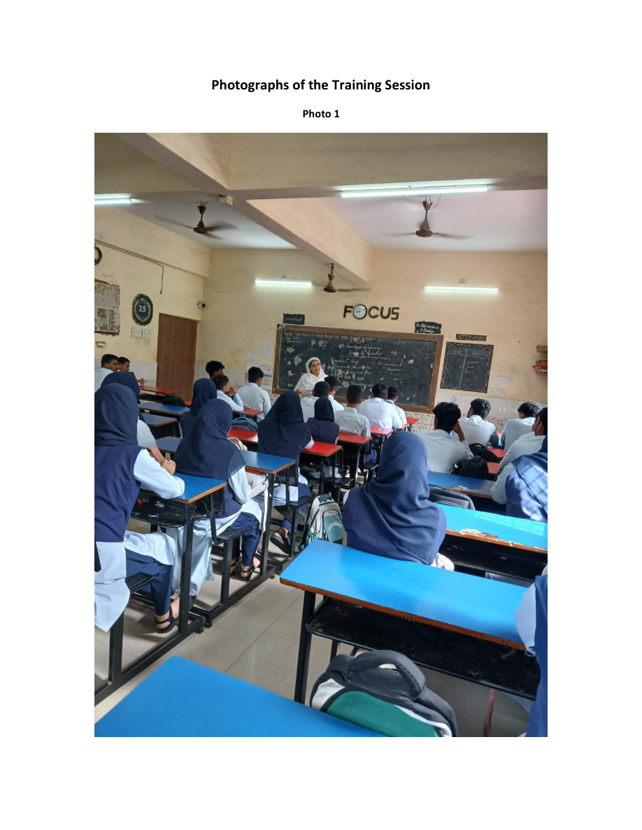
Training Session — Photograph 1
Photographic evidence from Week 6
SDG 4 • Inclusive Education | Week 6
17

Slide 36
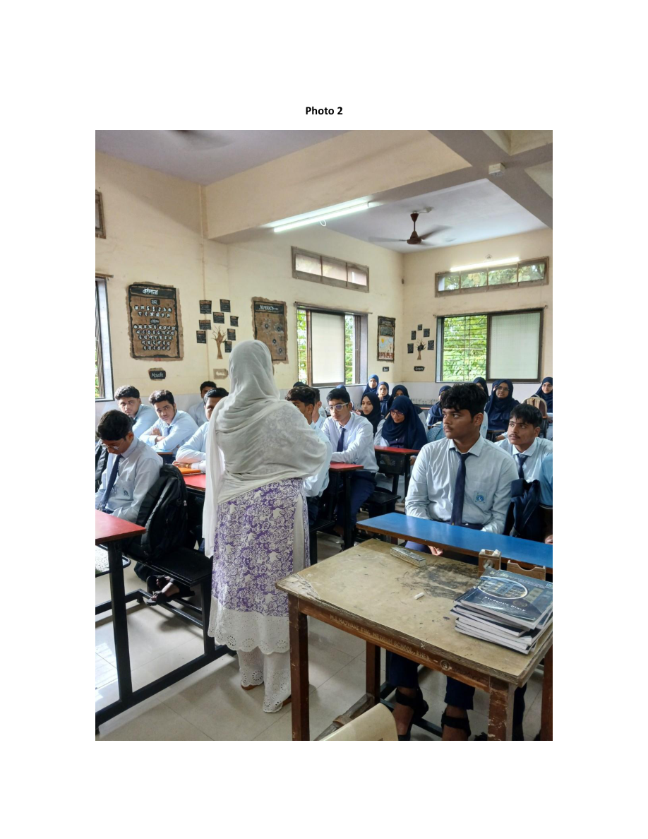
Training Session — Photograph 2
Photographic evidence from Week 6
SDG 4 • Inclusive Education | Week 6
18

Slide 37
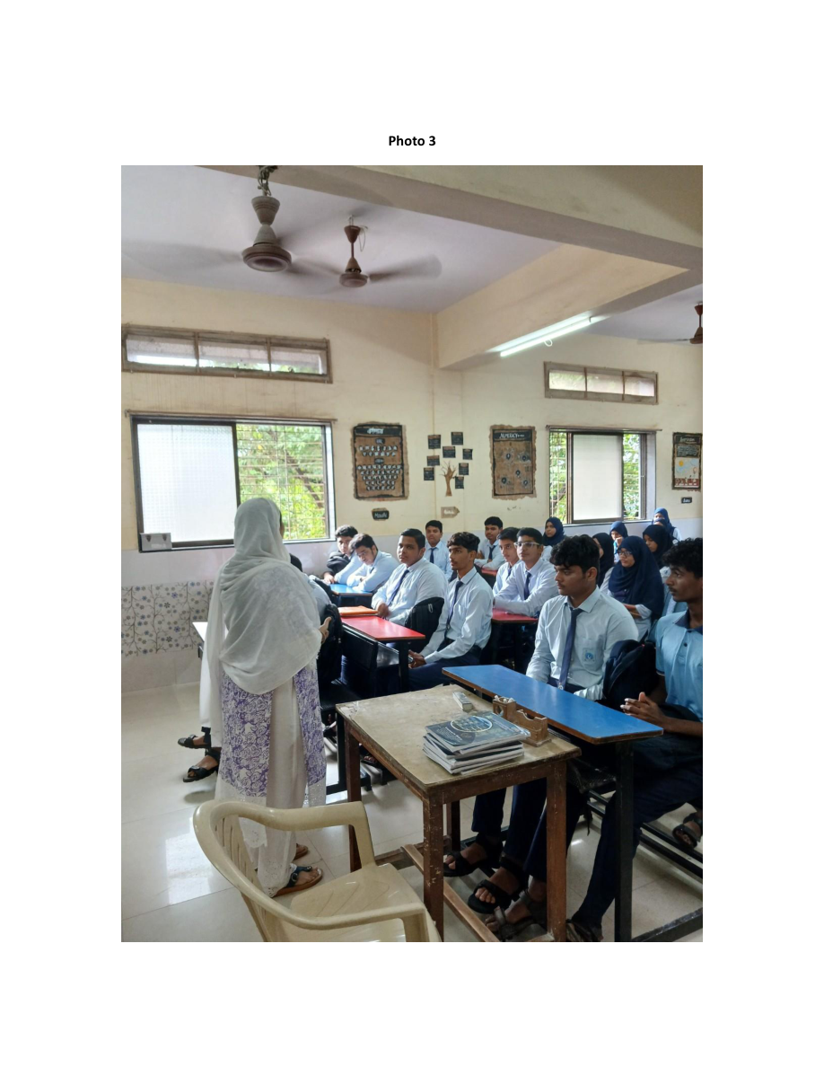
Training Session — Photograph 3
Photographic evidence from Week 6
SDG 4 • Inclusive Education | Week 6
19

Slide 38
Accessibility Audit & Improvements
WEEK
7
Reviewing school infrastructure, facilities and resources so every student can move, learn and participate comfortably.
M. I. Hajwani English Medium School & Jr. College, Khed

Slide 39
Purpose & Audit Methodology
Week 7 — Accessibility Audit
Purpose
Methodology
The audit checked whether school infrastructure, facilities and resources allow every student — regardless of physical ability or learning need — to move around, learn and participate comfortably.
The Accessibility Audit Committee walked through the entrance, classrooms, toilets, playground and common areas, observing facilities in use. Inputs were also gathered from teachers and students about day-to-day accessibility issues.
SDG 4 • Inclusive Education | Week 7
21

Slide 40
Existing Accessible Facilities
What was already available in the school
Ramp
Accessible toilet
Entrance ramp allows wheelchair users and students with mobility difficulties to enter without steps.
Separate specially designed toilet with appropriate support fixtures.
Special desks
Obstacle-free playground
Adjustable/adapted desks for students with physical disabilities.
Play area kept clear so differently-abled students can move and play safely.
Braille kit
Alphabet mat
Supports visually impaired students in reading and learning.
Tactile/visual aid supporting recognition of letters through play-based learning.
Wide doorways & corridors
Space allows easier wheelchair and mobility-aid movement.
SDG 4 • Inclusive Education | Week 7
22

Slide 41
Areas Needing Improvement
Gaps identified during the audit
Handrails
Ramp and staircases do not have continuous handrails for extra support.
Directional & Braille signage
No tactile or Braille signboards for classrooms, toilets or office.
Accessible drinking water
Existing taps/coolers are not at a height usable by wheelchair users or younger children.
Hearing support
No hearing loop or assistive listening device in the assembly hall.
Trained staff
Not all teachers/staff have training in sign language or assisting students with disabilities.
SDG 4 • Inclusive Education | Week 7
23

Slide 42
Suggestions & Recommendations
Practical next steps from the audit report
Recommendation 1
Recommendation 2
Install sturdy handrails along the ramp and staircases used by students.
Put up Braille and large-print signage at entrances, classrooms, staircases and the toilet block.
Recommendation 3
Recommendation 4
Provide a low-height drinking water station for wheelchair users and young children.
Explore a hearing loop system or FM assistive device for the assembly hall.
Recommendation 5
Recommendation 6
Organise short workshops for teachers on basic sign language and disability etiquette.
Keep at least one wheelchair available at school for emergency use.
Recommendation 7
Recommendation 8
Prepare an emergency evacuation plan that includes differently-abled students.
Consider a lift for easier access between floors, if the building has more than one storey.
Recommendation 9
Conduct the accessibility audit every year to track improvements.
SDG 4 • Inclusive Education | Week 7
24

Slide 43
Conclusion
Building an even more welcoming and accessible school
Already in place
Next priorities
SDG 4 vision
Ramp • accessible toilet • special desks • obstacle-free playground • Braille kit • alphabet mat • wide doorways/corridors
Handrails • Braille signage • accessible drinking water • hearing support • staff training • emergency planning
With practical improvements, the school can become even more welcoming and accessible for every student.
SDG 4 • Inclusive Education | Week 7
25

Slide 44
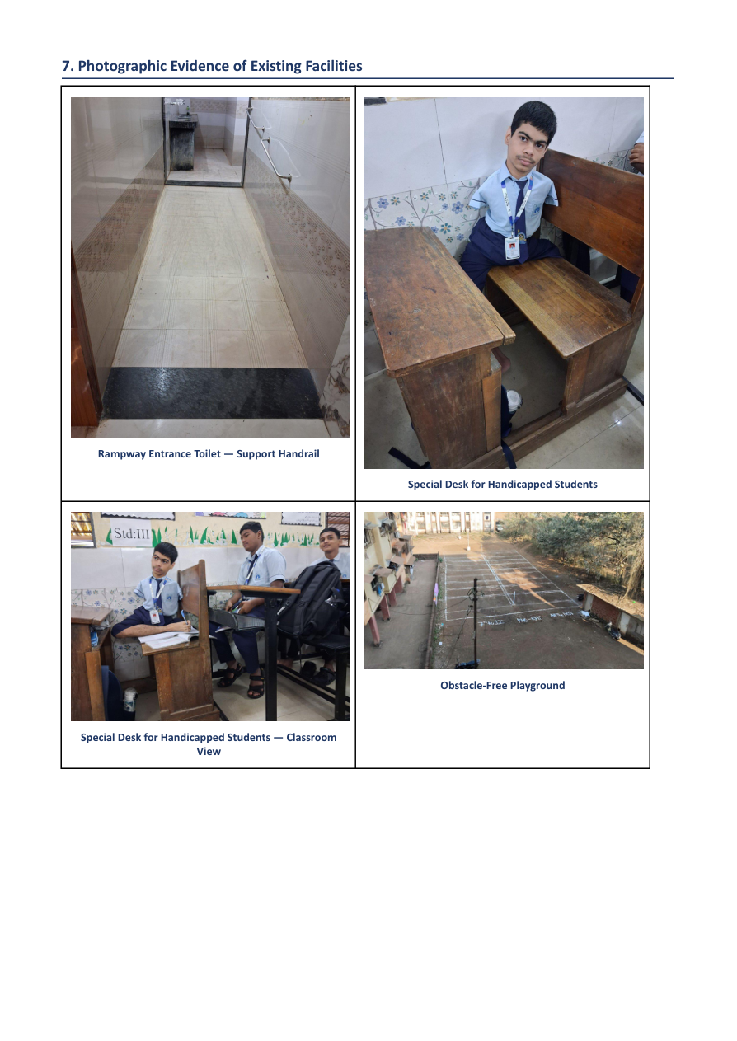
Accessibility Evidence — Photograph 1
Existing facilities documented in the audit report
SDG 4 • Inclusive Education | Week 7
26

Slide 45
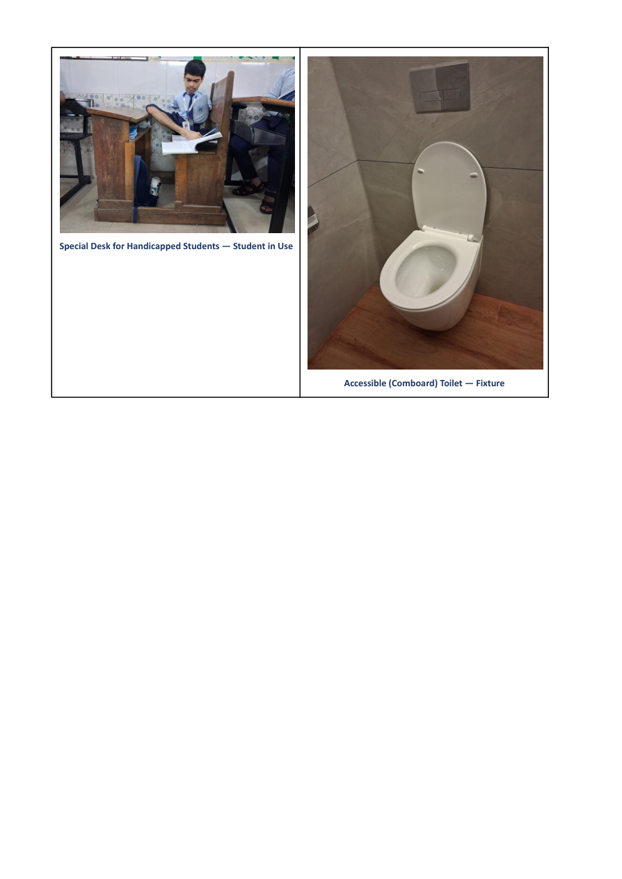
Accessibility Evidence — Photograph 2
Existing facilities documented in the audit report
SDG 4 • Inclusive Education | Week 7
27

Slide 46
WEEKS 4–7: INCLUSIVE EDUCATION IN ACTION
Week 4
Week 5
Week 6
Week 7
Inclusive language
Respectful, non-discriminatory communication that promotes equality, dignity and belonging.
Student list
Std. IX sections: Daisy, Rose, Marigold and Gerbera.
Teacher training
Differentiated instruction, peer support and inclusive classroom practices.
Accessibility audit
Existing strengths, identified gaps and practical improvements.
SDG 4 • Quality Education • M. I. Hajwani English Medium School & Jr. College, Khed

Slide 47
PEER SUPPORT THROUGH
ROBOTICS LAB ACTIVITY
Hands-on STEM / Experiential Learning
Teamwork • Peer Learning • Problem Solving • Creativity
M.I. Hajwani English Medium School & Jr. College, Khed
M.I. Hajwani English Medium School & Jr. College, Khed • Week 8
1

Slide 48
Robotics Lab Activity
Week 8 — Peer Support
Activity
Learning through activity
Students participated in a practical Robotics Lab activity in which they worked collaboratively to construct three-dimensional structures using colourful rods and connecting joints.
The activity provided an opportunity for students to learn through observation, experimentation, discussion and peer assistance.
M.I. Hajwani English Medium School & Jr. College, Khed • Week 8
2

Slide 49
How Peer Support Happened
Collaborative learning during construction
Peer Support 1
Peer Support 2
Students worked in pairs and supported each other during the construction process.
Peers shared materials, ideas and techniques while assembling the models.
Peer Support 3
Peer Support 4
Students guided classmates who needed help in connecting the rods and joints correctly.
Learners discussed possible solutions when they faced difficulties in constructing stable structures.
Peer Support 5
Students observed and appreciated one another’s work, encouraging cooperation and confidence.
M.I. Hajwani English Medium School & Jr. College, Khed • Week 8
3

Slide 50
Learning Outcomes
Skills developed through the activity
Outcome 1
Outcome 2
Developed teamwork and cooperative learning skills.
Improved communication and peer-support abilities.
Outcome 3
Outcome 4
Encouraged logical thinking and problem-solving.
Enhanced creativity and spatial understanding.
Outcome 5
Outcome 6
Built confidence through hands-on participation.
Promoted leadership, responsibility and mutual respect among students.
M.I. Hajwani English Medium School & Jr. College, Khed • Week 8
4

Slide 51
Inclusive & Interactive Learning Environment
What the photographs show
Learning environment
The photographs show students actively engaged in collaborative Robotics Lab work. They are seen assisting one another, discussing construction ideas and working together to complete their models.
The activity created an inclusive and interactive learning environment in which students could learn from both the teacher and their peers.
M.I. Hajwani English Medium School & Jr. College, Khed • Week 8
5

Slide 52
CONCLUSION
The Robotics Lab activity was a meaningful example of peer-supported experiential learning.
Through collaboration and hands-on model building, students strengthened their social, technical, communication and problem-solving skills.
The activity also encouraged students to learn together, help one another and participate confidently in STEM-based learning.
M.I. Hajwani English Medium School & Jr. College, Khed • Week 8
6

Slide 53
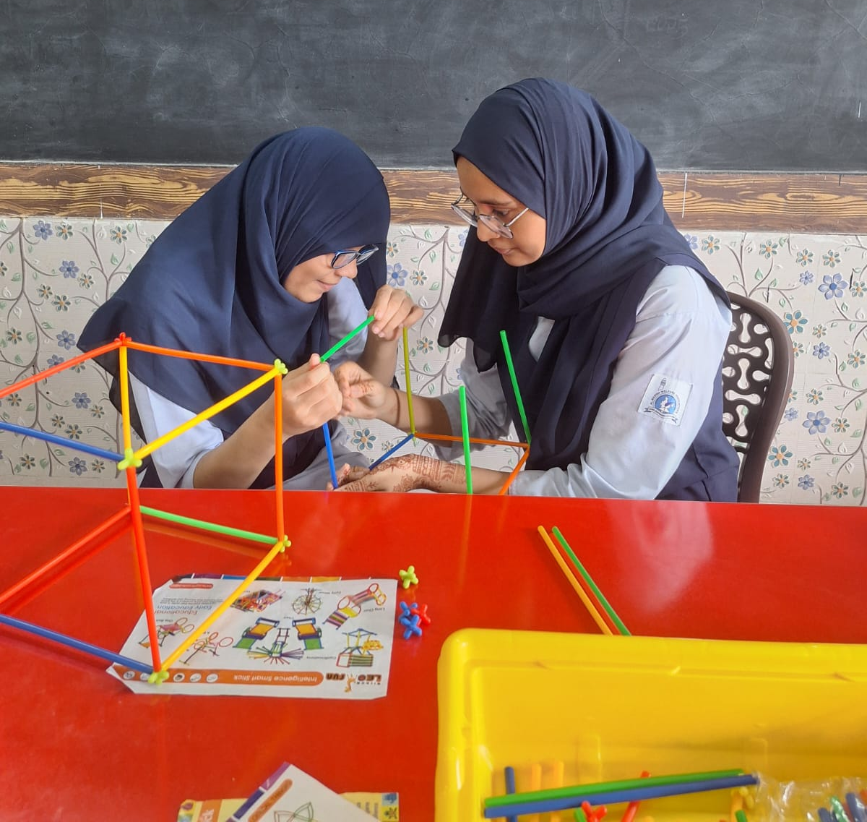
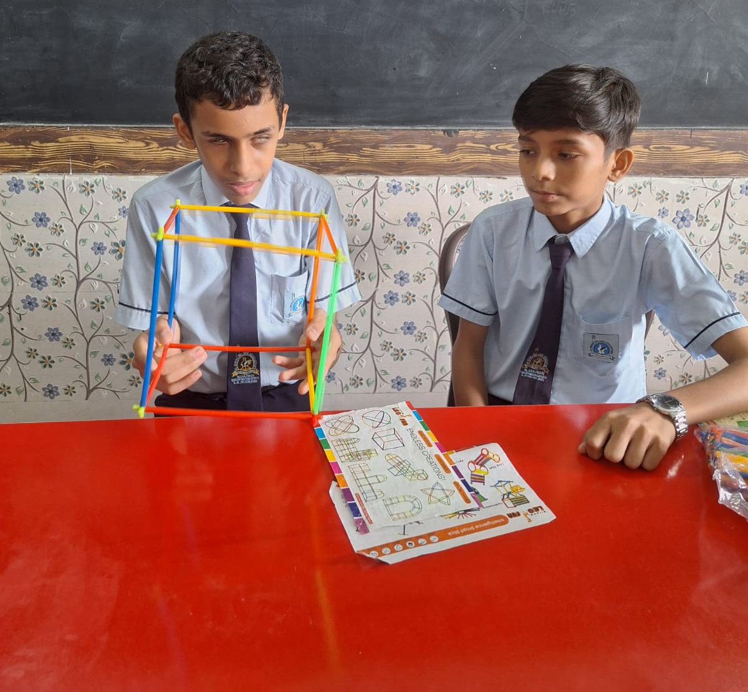
Photographic Documentation
Robotics Lab activity
Photograph 1
Photograph 2
Students engaged in collaborative Robotics Lab activity.
Students engaged in collaborative Robotics Lab activity.
M.I. Hajwani English Medium School & Jr. College, Khed • Week 8
7

Slide 54
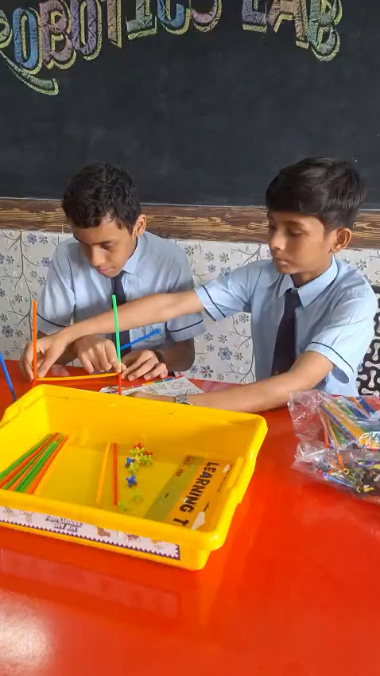
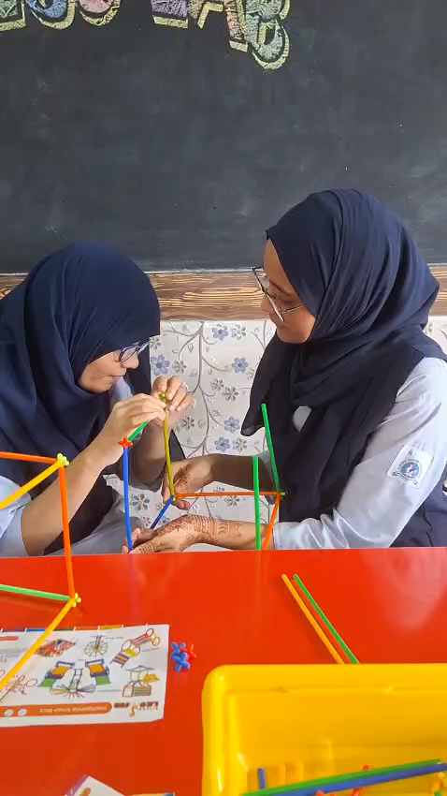

Slide 55

Week 9
Inclusive Education

Slide 56
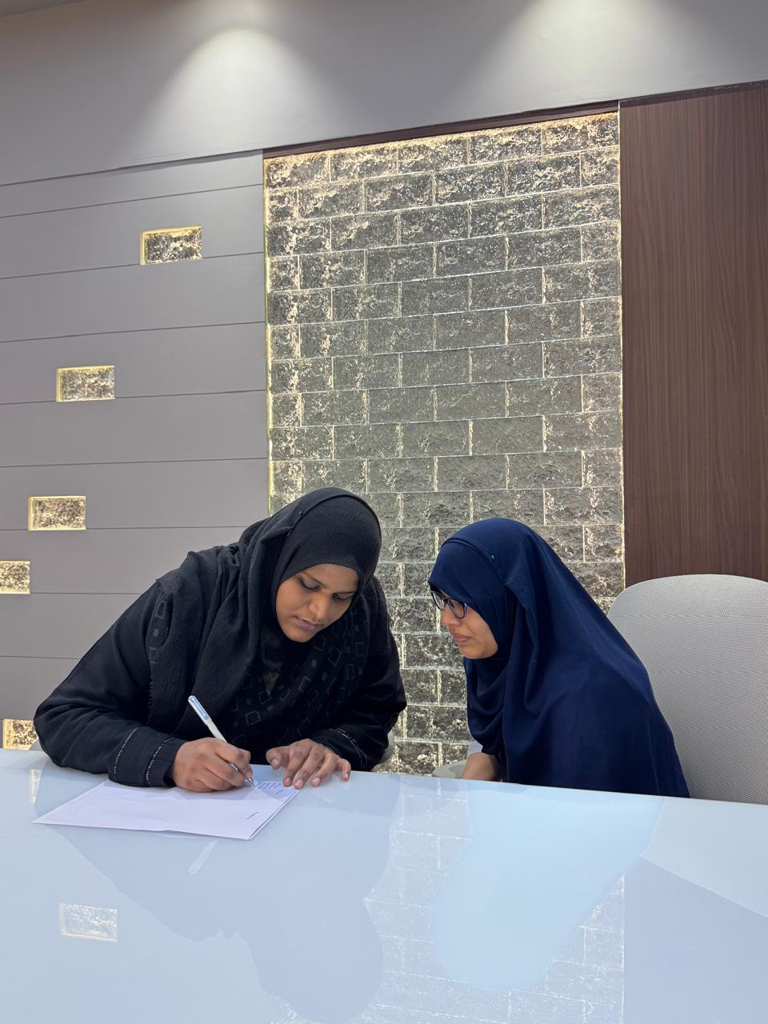

Slide 58
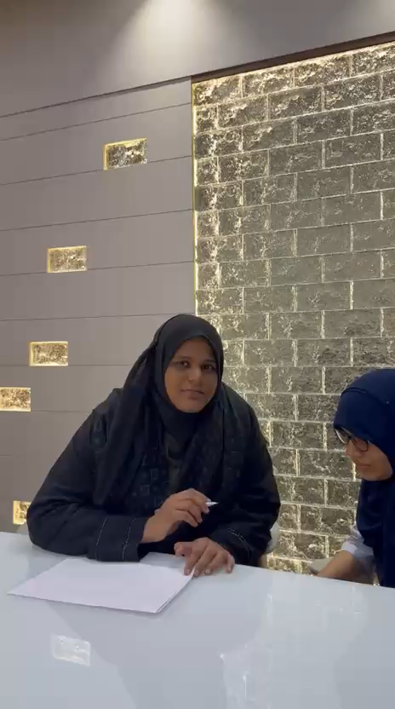

Slide 59
For SDG 4: Inclusive Education project at
M.I. Hajwani School, here are practical practices we can include:
1. Classroom & Teaching Practices
- Differentiated Instruction: Give different ways to learn the same topic. E.g: videos, diagrams, hands-on experiments, and reading for Science.
- Universal Design for Learning (UDL): Plan lessons with multiple means of engagement, representation, and expression.
- Flexible Grouping: Mix students of different abilities for projects, labs, and peer teaching. Rotate groups so no one is always "helper" or "helped".
- Multiple Assessment Options: Allow students to show understanding via quiz, poster, model, presentation, or oral explanation.
2. Peer Support & Collaboration
- Buddy System: Pair students to help each other in classwork and practicals.
- Peer Tutoring: Stronger students mentor others in specific topics, and vice-versa for different subjects.
- Circle Time / Sharing Sessions: 10 min weekly to discuss challenges and celebrate efforts.
3. Accessibility & Environment
- Accessible Materials: Big font handouts, audio explanations, sign language/visual aids for hearing impaired.
- Physical Accessibility: Check ramps, lab tables height, seating arrangement for students with mobility needs.
4. Teacher & Student Support
- Teacher Training Workshops: On handling diverse learners, using assistive tech, and positive behavior support.
- Student Sensitization: Awareness sessions on empathy, disability etiquette, and inclusion.
5. Documentation for Project
1. Photos of group work, accessible classroom setup
2. Lesson plans showing differentiation

Slide 60
COMMUNITY LEARNING & ENGAGEMENT REPORT
Super Memory Masterclass
An in-person community masterclass on memory and learning techniques — attended by families, adults, and children.
Week 10 | Event Format: In-person session | Prepared from photographic event documentation

Slide 61
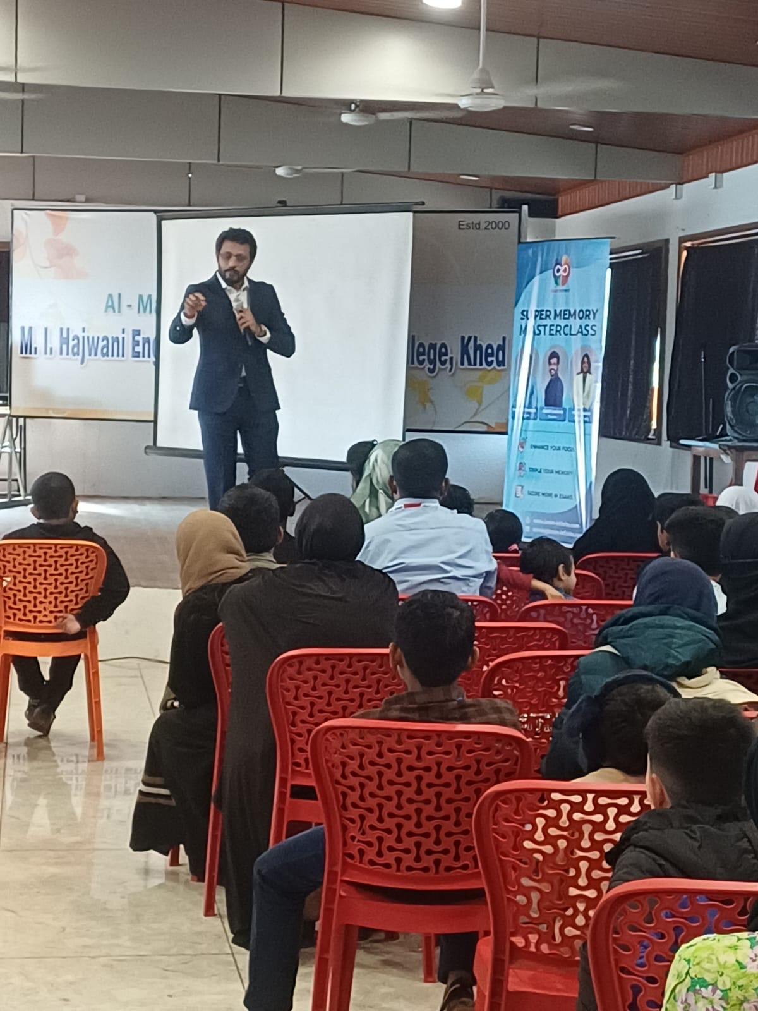
Event Snapshot
Key facts about the session, drawn from the supplied event photographs
EVENT
Super Memory Masterclass
FORMAT
In-person community learning session
AUDIENCE
Community members, families, and young participants
REPORT BASIS
Event photographs and visible event materials
Super Memory Masterclass • Community Event Report
02

Slide 62
Executive Summary
3
The Super Memory Masterclass was conducted as an in-person community learning event with a strong emphasis on participation, demonstration, and practical learning.
The photographs show a well-attended session in a hall arranged with rows of chairs, a presentation screen, event signage, and audio equipment.
The session brought together a mixed audience that included adults, families, and children. The presenter engaged directly with the audience while using a microphone and presentation materials. Several attendees were observed documenting the session on their mobile phones, indicating active interest and engagement.
Photos documented
All ages
Audience range
Live
Presenter engagement
Super Memory Masterclass • Community Event Report
03

Slide 63
Purpose & Objectives
What the masterclass set out to achieve for the community
01
Create an accessible community learning opportunity around memory and learning techniques.
02
Encourage active audience participation rather than one-way instruction.
03
Provide practical demonstrations that participants could observe and potentially apply after the event.
04
Promote interest in continued learning and community-based educational activities.
Super Memory Masterclass • Community Event Report
04

Slide 64
Event Overview
SESSION COMPONENTS
The event appears to have been organized as a masterclass-style educational session.
Visible signage identifies the program as a “Super Memory Masterclass,” while the venue was configured for a presentation to a sizable community audience.
The program included a central speaker, a projection screen, supporting visual material, and sound equipment.
Central speaker / presenter
Projection screen
Event banner & signage
Microphone & sound system
Rows of seating for attendees
Super Memory Masterclass • Community Event Report
05

Slide 65
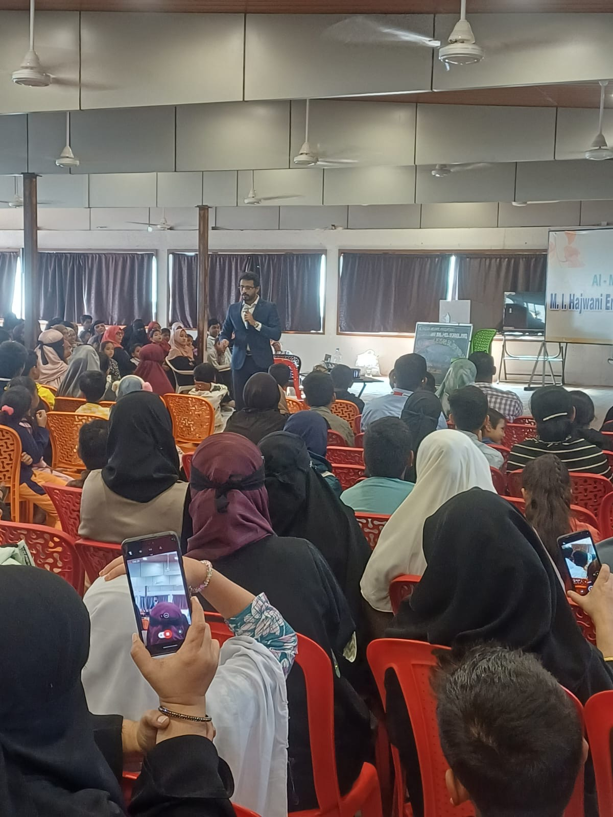
Community Participation
& Engagement
The supplied photographs demonstrate broad participation across age groups. The audience was seated throughout the hall, with many participants focused toward the speaker and screen.
The presence of children and families suggests that the session was designed to be approachable for a general community audience rather than a narrowly specialized group.
Audience members were also seen recording portions of the session on smartphones — a visible sign of interest, suggesting participants considered the content useful enough to preserve or share.
Super Memory Masterclass • Community Event Report
06

Slide 66
Key Highlights
1
2
3
Strong Attendance
Interactive Delivery
Family-Oriented
The photographs show a substantial audience occupying most of the available seating.
The presenter is shown speaking from within the audience area as well as the front, suggesting an engaging delivery style.
Adults, young people, and children are all visible among the participants.
4
5
Visual & Audio Support
Participant Documentation
A projection screen, event banner, microphone, and sound equipment supported the session.
Multiple attendees used mobile phones to record or photograph the session.
Super Memory Masterclass • Community Event Report
07

Slide 67
Observations
The event environment appears energetic and community-focused. The seating arrangement, large projection area, and visible event branding created a clear learning environment.
The photographs also suggest that the event attracted a diverse group of participants, which can strengthen peer learning and community interaction.
Energetic atmosphere
Clear learning environment
Diverse participant mix
Strong peer-learning potential
Super Memory Masterclass • Community Event Report
08

Slide 68
Recommendations for Future Events
✓
Continue using interactive demonstrations and audience participation to maintain attention.
✓
Provide a short printed or digital takeaway summarizing the main techniques discussed.
✓
Use a simple attendance or feedback form to capture participant numbers, satisfaction, and suggestions.
✓
Consider dedicated seating or activity areas for children and families when appropriate.
✓
Collect a small number of voluntary participant comments or testimonials to document community impact.
✓
Maintain a photo record of key moments, while obtaining appropriate consent where required.
Super Memory Masterclass • Community Event Report
09

Slide 69
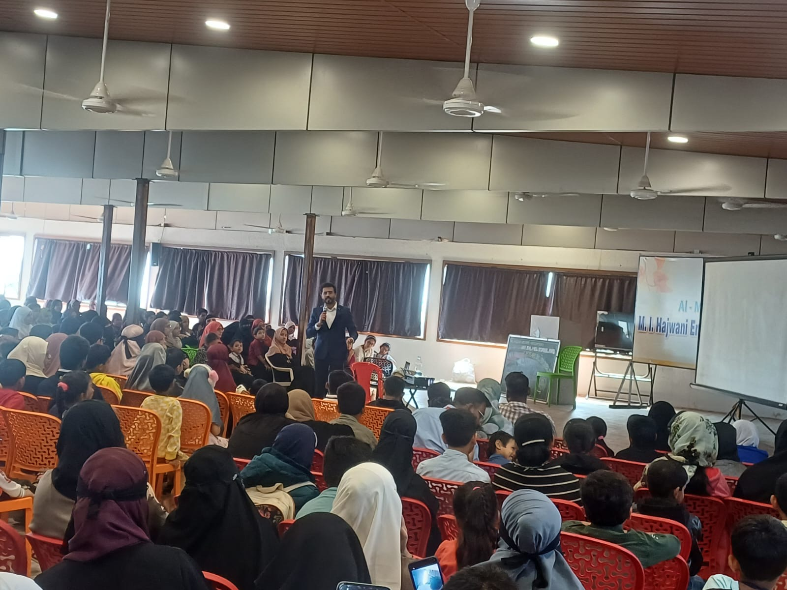
Photographic Documentation
Captions describe the setting and activity without identifying individual attendees.
Photo 1: Session in progress with the presenter addressing participants from the front of the hall.
Photo 2: Audience engagement during the masterclass; participants seated throughout the venue.
Photo 3: Wide view of the community audience and presentation area during the session.
Super Memory Masterclass • Community Event Report
10

Slide 70
Conclusion
Based on the supplied photographs, the Super Memory Masterclass was a well-attended community learning activity that created an opportunity for participants to engage with educational content in a shared setting.
The visible audience participation, family presence, and use of presentation and audio facilities indicate a positive and organized learning environment. Future editions can build on this foundation by formally capturing attendance, feedback, learning outcomes, and follow-up activities.
REPORT NOTE
This report was prepared from the three photographs supplied for documentation. Specific details such as the exact event date, venue name, organizer, attendance count, speaker name, agenda, and participant feedback were not provided in the source material and should be added from official event records before formal publication.
11

Slide 71
SDG GOAL 4 · QUALITY EDUCATION
Inclusive Education Project
Week 11 Evaluation Report & Week 12 Final Report
SCHOOL
M.I. Hajwani English Medium School & Jr. College, Khed
DEPARTMENT
English & Commerce Department
PROGRAMME
Student Sensitization Programme — Learning Needs, Facilities & Inclusion
DOCUMENTS COMBINED
Week 11 Evaluation Report · Week 11 Follow-Up Survey · Week 12 Final Report
GUIDED BY
Mrs. Kadiri Shagufta – HOD, Commerce
SUBMITTED TO
National Education Board
M.I. Hajwani English Medium School & Jr. College, Khed
1

Slide 72
PART ONE
Week 11 — Evaluation Report
Student Sensitization Programme: Learning Needs, Facilities & Inclusion
M.I. Hajwani English Medium School & Jr. College, Khed
2

Slide 73
EXECUTIVE SUMMARY
Baseline (Week 2) vs. Follow-Up (Week 11) — 100 Students Each
88%
86%
78%
of follow-up respondents reported becoming more aware of the issues covered by the programme
reported a positive shift in attitude since the programme began
said they would recommend the programme to other classes
Overall Finding
This report evaluates the impact of the student sensitization programme on Learning Needs, Facilities, and Gender & Diversity, comparing a baseline needs-assessment survey (Week 2) with a follow-up survey (Week 11), each completed by 100 students. The comparison shows a broadly positive shift across all three areas measured. Facilities and accessibility remain areas for continued attention, consistent with priorities identified at baseline.
M.I. Hajwani English Medium School & Jr. College, Khed
3

Slide 74
BACKGROUND & PURPOSE
Why This Evaluation Was Conducted
In Week 2, a baseline needs-assessment survey was conducted to understand students' learning needs, their experience of school facilities, and their perceptions of gender equality and diversity.
•
The findings informed the design and priorities of a sensitization campaign delivered between Weeks 3 and 10, focused on inclusion, respect, accessibility and academic support.
•
In Week 11, a follow-up survey was conducted with the same student population to measure change in awareness and attitude since the programme began, and to assess whether the priorities identified at baseline had been experienced as improving.
•
M.I. Hajwani English Medium School & Jr. College, Khed
4

Slide 75
METHODOLOGY
Two Surveys, One Student Population
Baseline Survey — Week 2
Follow-Up Survey — Week 11
• Title: Student Survey — Learning Needs, Facilities & Inclusion
• Title: Student Follow-Up Survey — Change in Awareness & Attitude
• Format: Anonymous paper questionnaire, 20 questions across 3 sections
• Format: Anonymous questionnaire, 18 questions across 5 sections
• Sample: 100 students, one class per grade level
• Sample: 100 students
• Purpose: To measure change since baseline in awareness, attitude, learning support, facilities, and perceptions of equality and inclusion
Note: the follow-up survey asked students to rate change directly (e.g. “easier than before”), while the baseline survey measured absolute status at a single point in time. Where questions correspond, this report compares baseline status against the direction and scale of change reported at follow-up.
M.I. Hajwani English Medium School & Jr. College, Khed
5

Slide 76
BASELINE VS. FOLLOW-UP COMPARISON — 4.1
Learning Needs
Indicator | Baseline (Week 2) | Follow-Up (Week 11)
Find it easy to follow lessons | 52% said “Always” | 83% said easier (52% much easier, 31% a little easier)
Comfortable asking teacher for help | 61% said “Yes” | 68% said more comfortable
Enough time to finish classwork | 57% said “Yes” | 63% said “Yes”
Know where to get extra help | 68% said “Yes” | 82% said “Yes”
M.I. Hajwani English Medium School & Jr. College, Khed
6

Slide 77
BASELINE VS. FOLLOW-UP COMPARISON — 4.2
Facilities
Indicator | Baseline (Week 2) | Follow-Up (Week 11)
Facilities easy to use/reach | 86% said “Yes” | 57% said easier; 29% about the same (86% combined)
Feel safe moving around school | 89% said “Yes” | 64% said safer; 25% about the same (89% combined)
M.I. Hajwani English Medium School & Jr. College, Khed
7

Slide 78
BASELINE VS. FOLLOW-UP COMPARISON — 4.3
Gender & Diversity
Indicator | Baseline (Week 2) | Follow-Up (Week 11)
Boys and girls treated equally | 74% said “Yes” | 62% said more equally; 27% about the same (89% combined)
Class respects different backgrounds | 76% said “Yes” | 66% said more; 25% about the same (91% combined)
Witnessed unkind comments | 22% said “Yes” (baseline concern) | 59% noticed fewer such comments since the programme
Free to share opinions regardless of gender | 71% said “Yes” | 67% said more free; 24% about the same (91% combined)
Equal chances in activities/sports/leadership | 73% said “Yes” | 65% said more equal; 26% about the same (91% combined)
M.I. Hajwani English Medium School & Jr. College, Khed
8

Slide 79
FOLLOW-UP SURVEY FINDINGS — 5.1
Section A: Overall Change Since the Programme
Question | Response | Students | %
1. Understanding of topics | Improved a lot | 58 | 58%
 | Improved a little | 29 | 29%
 | Stayed the same | 11 | 11%
 | Got worse | 2 | 2%
2. Awareness of issues | Much more aware | 61 | 61%
 | A little more aware | 27 | 27%
 | About the same | 10 | 10%
 | Less aware | 2 | 2%
3. Attitude / way of thinking | Yes, a lot | 55 | 55%
 | Yes, a little | 31 | 31%
 | No change | 11 | 11%
 | Not sure | 3 | 3%
M.I. Hajwani English Medium School & Jr. College, Khed
9

Slide 80
FOLLOW-UP SURVEY FINDINGS — 5.1 (CONTINUED)
Question 4: What Helped Change Attitudes
Factor | Students | %
Classroom discussions | 32 | 32%
Activities and group work | 25 | 25%
Teacher explanations | 21 | 21%
Stories, examples and videos | 14 | 14%
Discussions with classmates | 8 | 8%
Question 4 asked students what helped change their attitude, following on from Question 3.
M.I. Hajwani English Medium School & Jr. College, Khed
10

Slide 81
FOLLOW-UP SURVEY FINDINGS — 5.2
Section B: Learning Needs Revisited
Question | Response | Students | %
5. Following lessons | Much easier | 52 | 52%
 | A little easier | 31 | 31%
 | About the same | 14 | 14%
 | Harder | 3 | 3%
6. Asking teachers for help | Yes | 68 | 68%
 | About the same | 24 | 24%
 | No | 8 | 8%
7. Enough time for classwork | Yes | 63 | 63%
 | No | 12 | 12%
 | Sometimes | 25 | 25%
8. Know where to get extra help | Yes | 82 | 82%
 | No | 18 | 18%
M.I. Hajwani English Medium School & Jr. College, Khed
11

Slide 82
FOLLOW-UP SURVEY FINDINGS — 5.3
Section C: Facilities Revisited
Question | Response | Students | %
9. Access to school facilities | Yes, easier | 57 | 57%
 | About the same | 29 | 29%
 | No | 8 | 8%
 | Not sure | 6 | 6%
10. Feeling safer around school | Yes, safer | 64 | 64%
 | About the same | 25 | 25%
 | No | 5 | 5%
 | Sometimes | 6 | 6%
M.I. Hajwani English Medium School & Jr. College, Khed
12

Slide 83
FOLLOW-UP SURVEY FINDINGS — 5.4
Section D: Gender & Diversity (Q11–Q13)
Question | Response | Students | %
11. Equal treatment of boys and girls | Yes, more equally | 62 | 62%
 | About the same | 27 | 27%
 | No | 6 | 6%
 | Not sure | 5 | 5%
12. Respect for different backgrounds | Yes, more | 66 | 66%
 | About the same | 25 | 25%
 | Less | 4 | 4%
 | Not sure | 5 | 5%
13. Unkind comments | Yes, fewer | 59 | 59%
 | About the same | 29 | 29%
 | No, more | 5 | 5%
 | Prefer not to say | 7 | 7%
M.I. Hajwani English Medium School & Jr. College, Khed
13

Slide 84
FOLLOW-UP SURVEY FINDINGS — 5.4 (CONTINUED)
Section D: Gender & Diversity (Q14–Q15)
Question | Response | Students | %
14. Freedom to share opinions | Yes, more free | 67 | 67%
 | About the same | 24 | 24%
 | No | 4 | 4%
 | Not sure | 5 | 5%
15. Equal opportunities | Yes, more equal | 65 | 65%
 | About the same | 26 | 26%
 | No | 5 | 5%
 | Not sure | 4 | 4%
M.I. Hajwani English Medium School & Jr. College, Khed
14

Slide 85
FOLLOW-UP SURVEY FINDINGS — 5.5
Section E: Overall Reflection (Q16–Q17)
Q16 — Most important things students learned or realized
Q17 — Changes students would still like to see
Response theme | Students | %
Respecting differences and diversity | 28 | 28%
Treating everyone equally | 24 | 24%
Being more confident about sharing opinions | 18 | 18%
Understanding different learning needs | 16 | 16%
Importance of kindness and inclusion | 14 | 14%
Suggested area | Students | %
More inclusive activities and events | 24 | 24%
Better accessibility, incl. ramps & movement | 21 | 21%
More opportunities to express opinions | 18 | 18%
More awareness programmes | 17 | 17%
Better facilities and common areas | 12 | 12%
No major changes suggested | 8 | 8%
M.I. Hajwani English Medium School & Jr. College, Khed
15

Slide 86
FOLLOW-UP SURVEY FINDINGS — 5.5 (CONTINUED)
Section E: Overall Reflection (Q18)
Q18 — Would you recommend this programme to other classes?
78%
18%
4%
Yes — 78 students
Maybe — 18 students
No — 4 students
M.I. Hajwani English Medium School & Jr. College, Khed
16

Slide 87
ANALYSIS & INTERPRETATION
What the Comparison Tells Us
The comparison between baseline and follow-up results indicates measurable positive change across all three focus areas of the programme:
•
Learning Needs: Every learning-related indicator improved. The clearest gain is in students knowing where to get extra help, up from 68% to 82%, suggesting the campaign's signposting of academic support was effective.
•
Facilities: Facilities indicators held steady or improved slightly when “about the same” responses are included, but the baseline priorities around quiet spaces and accessibility (ramps, handrails) were not directly re-measured in the follow-up survey and remain open questions for a future facilities-specific check-in.
•
Gender & Diversity: The most notable shift is in witnessing unkind comments — 22% reported witnessing them at baseline, and 59% of follow-up respondents reported noticing fewer such comments since the programme, consistent with the sensitization campaign's gender/diversity focus.
•
Student voice and equal opportunity indicators (Q14, Q15 follow-up) each show over 90% combined positive response (improved or steady), suggesting the programme reinforced an already reasonably positive baseline rather than correcting a deficit.
•
A consistent minority of students (roughly 10-29% depending on the indicator) reported “about the same” or “no change,” indicating that while the programme had broad positive reach, it did not shift every student's experience, and continued reinforcement is likely needed.
M.I. Hajwani English Medium School & Jr. College, Khed
17

Slide 88
RECOMMENDATIONS
Week 11 Evaluation Report
Continue awareness and inclusion activities: Sustained programming is likely needed to reach the 10-29% of students who reported no change, and to consolidate gains among those who improved.
•
Follow up on facilities priorities from baseline: The Week 2 priorities around a quiet/calm space and accessibility (ramps, handrails, pathways) were not directly re-tested at follow-up. A short facilities-specific check-in is recommended to confirm whether these were addressed.
•
Expand peer and teacher-led support: Classroom discussions, activities/group work, and teacher explanations were the top three factors students cited for changing their attitudes — these approaches should be prioritized in future sessions over passive formats.
•
Create more channels for student voice: 18% of students still want more opportunities to express opinions; consider structured forums, suggestion boxes, or student councils.
•
Maintain academic support signposting: The jump in students knowing where to get help (68% → 82%) suggests continuing to actively communicate support channels, rather than assuming awareness persists on its own.
•
M.I. Hajwani English Medium School & Jr. College, Khed
18

Slide 89
CONCLUSION
Week 11 Evaluation Report
Overall, the follow-up survey shows a positive shift from the Week 2 baseline across learning needs, facilities, and gender & diversity. Most students reported improvements in awareness, understanding, classroom participation, access to support, and perceptions of inclusion, and 78% said they would recommend the programme to other classes.
The findings support continuing the programme's core activities — classroom discussion, group work, and teacher-led explanation — while directing renewed attention to the facilities priorities identified at baseline (quiet space, accessibility) that were not directly re-measured in this follow-up.
End of Report — Week 11 Evaluation Report
M.I. Hajwani English Medium School & Jr. College, Khed
19

Slide 90
SURVEY INSTRUMENT
Week 11 Follow-Up Survey — Structure
Student Follow-Up Survey: Change in Awareness & Attitude — anonymous, 18 questions across 5 sections.
Section A
Overall Change Since the Programme
Q1–Q4: understanding, awareness, attitude change, and what helped change it
Section B
Learning Needs — Revisited
Q5–Q8: following lessons, asking for help, classwork time, knowing where to get help
Section C
Facilities — Revisited
Q9–Q10: ease of access and feeling safe around the school
Section D
Gender & Diversity — Change in Attitude
Q11–Q15: equal treatment, respect, unkind comments, freedom to share opinions, equal chances
Section E
Overall Reflection
Q16–Q18: most important learning, remaining changes wanted, recommendation to other classes
M.I. Hajwani English Medium School & Jr. College, Khed
20

Slide 91
PART TWO
Week 12 — Final Report
12-Week SDG Project on Inclusive Education · SDG Goal 4: Quality Education
M.I. Hajwani English Medium School & Jr. College, Khed
21

Slide 92
Introduction
Education is a right for all. This 12-week project was designed to promote inclusive education in our school, ensuring that every student — regardless of learning needs, gender, or background — feels valued and supported.
Through surveys, campaigns, workshops, and community involvement, the project set out to build a school culture rooted in four values:
Empathy
Respect
Equality
Equal Opportunity
“No Student is
Left Behind.”
Project focus: Inclusive Education, Equal Opportunity, Accessibility, Peer Support, and Community Participation.
M.I. Hajwani English Medium School & Jr. College, Khed
22

Slide 93
PROJECT TIMELINE · PART 1
Weeks 1 – 6: From Launch to Training
1
Project Launch
Introduction to SDG 4; four student committees formed
Committee List
2
Needs Assessment
Student survey and facility mapping
Survey & Analysis Report
3
Research & Planning
Research on learning difficulties, gender and diversity
Campaign Plan & Notes
4
Campaign Design
Posters, role plays and language guidelines prepared
Campaign Materials
5
Sensitization Drive
Assembly and classroom sessions on diversity
Attendance & Feedback
6
Teacher & Student Workshop
Training on differentiated instruction
Workshop Report & Photos
M.I. Hajwani English Medium School & Jr. College, Khed
23

Slide 94
PROJECT TIMELINE · PART 2
Weeks 7 – 12: From Audit to Handover
7
Accessibility Audit
Audit of ramps, laboratories and learning resources
Accessibility Audit Report
8
Peer Support Programme
Buddy system and peer mentoring launched
Peer Support Documentation
9
Inclusive Learning Practices
Group work and flexible assignments
Best Practices Record
10
Community Engagement
Parent session and expert talk
Community Engagement Report
11
Evaluation
Follow-up survey to measure change
Evaluation Report
12
Presentation & Handover
Final presentation and sustainability planning
Final Report & Sustainability Plan
M.I. Hajwani English Medium School & Jr. College, Khed
24

Slide 95
KEY FINDINGS
From Awareness to Measurable Impact
85%+
30+
12
2
of students can now explain the meaning of inclusive language and understand why it matters
parents attended the community awareness session
teachers trained in differentiated instruction & peer-support techniques
priority accessibility fixes identified: ramp railing & lab seating
Student Behaviour & Community Response
Group participation increased and students reported feeling more comfortable asking for help. Beyond attendance, 2 parents volunteered to support future programmes — a signal of genuine buy-in, not just turnout.
M.I. Hajwani English Medium School & Jr. College, Khed
25

Slide 96
PROBLEM SOLVING
Challenges & Solutions
Challenge | Solution Implemented
Low initial parent turnout | Session rescheduled; WhatsApp reminders sent in the local language
Time constraints due to the syllabus | Activities integrated into regular periods and school assemblies
Shyness among students about peer support | Volunteer “Peer Buddies” launched the programme; certificates encouraged participation
M.I. Hajwani English Medium School & Jr. College, Khed
26

Slide 97
LOOKING AHEAD
Recommendations
Make Inclusive Education an integral part of the school's annual policy
•
Conduct quarterly parent-orientation programmes
•
Conduct an annual accessibility audit of school facilities
•
Introduce “Best Buddy” Awards every term to sustain motivation and participation
•
M.I. Hajwani English Medium School & Jr. College, Khed
27

Slide 98
SUSTAINABILITY PLAN
Keeping the Momentum Beyond Week 12
Area | Activity | Responsible | Frequency
Peer Support | Continue Buddy System in all classes | Class Teachers + Student Council | Weekly
Awareness | One Inclusive Education Assembly | Assembly In-charge | Monthly
Teacher Training | Mini-workshop on inclusive teaching | HOD + Senior Teachers | Every Term
Accessibility | Annual audit of school facilities | Infrastructure Committee | Yearly
Community | Parent orientation on inclusion | PTA Committee | Twice a Year
Documentation | Maintain Student Reflection Journals | Subject Teachers | Every Term
M.I. Hajwani English Medium School & Jr. College, Khed
28

Slide 99
MONITORING & RESOURCES
Keeping Track of Progress
WEEKLY
MONTHLY
TERM-WISE
Teachers review the Buddy System and student participation
Collect student feedback and review inclusion-related activities
Review progress and challenges during staff meetings
Class Teachers
Student Council
School Management & Staff
RESOURCES REQUIRED
Posters & awareness materials
Library books for inclusive learning
Teacher-training materials
Student reflection journals
Support from HOD & Principal
M.I. Hajwani English Medium School & Jr. College, Khed
29

Slide 100
CONCLUSION
From Awareness to Action
Over the course of 12 weeks, the project successfully moved from awareness to action. Inclusive Education is not a one-time event but an ongoing commitment. With the continued support of students, teachers, parents, and school management, we are committed to creating an environment where:
“No Student is Left Behind.”
ANNEXURES
All 9 NEB Deliverables, along with photographs, reports, survey results, and feedback forms, are attached as annexures.
LONG-TERM VISION
Everyone Belongs. Everyone Learns. Everyone is Respected. — The school aims to build a sustainable culture of inclusion in which every learner receives equal respect, encouragement, participation, and opportunity to succeed.
M.I. Hajwani English Medium School & Jr. College, Khed
30

Slide 101
PROJECT DECLARATION
Project Declaration
Particular | Details
Project Title | 12-Week SDG Project on Inclusive Education
SDG Goal | Goal 4 – Quality Education
School | M.I. Hajwani English Medium School & Jr. College, Khed
Department | English & Commerce Department
Project Duration | 12 Weeks
Project Focus | Inclusive Education, Equal Opportunity, Accessibility, Peer Support, and Community Participation
M.I. Hajwani English Medium School & Jr. College, Khed
31

Slide 102
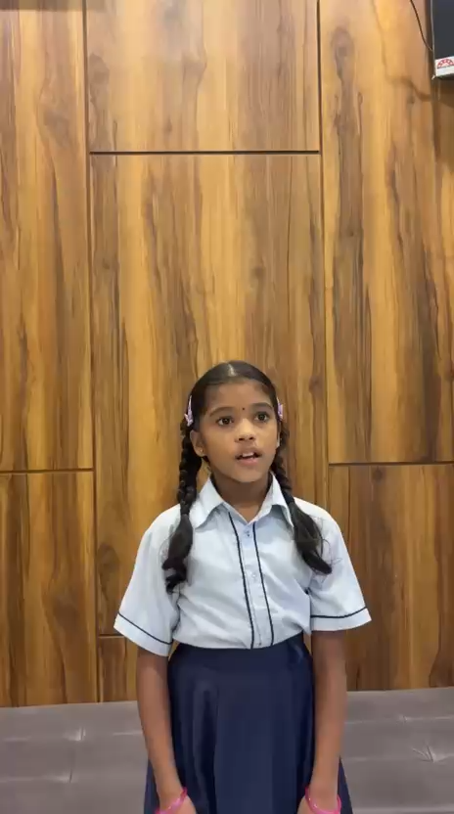
M.I. Hajwani English Medium School & Jr. College, Khed
31

Slide 103


Slide 104
THANK YOU
Everyone Belongs.
Everyone Learns.
Everyone is Respected.
Student Committee · English & Commerce Department · Guided by Mrs. Kadiri Shagufta (HOD, Commerce)
Submitted to the National Education Board
M.I. Hajwani English Medium School & Jr. College, Khed
32

